Slide 1







FROM COURT TO CODE
Analysis of ECHR Article Citations
GABRIELE & LIUBOV

Slide 2



Research topic
To find what articles of the ECHR are most often cited together in ECHR case law

Slide 3
Outline
I. Data Collection
II. Article Combinations
III. Analysis of Results
IV. Conclusion

Slide 4


Data collection method
(around 25,800 cases)
Method I:
Method II:
Method III:
echr-extractor library
Limitation of how many cases can be treated
Scraping
HUDOC website barriers on scraping
Using already existent .csv file with cases
Extracting additional two files of new cases (limit of 500 cases per export)

Slide 5

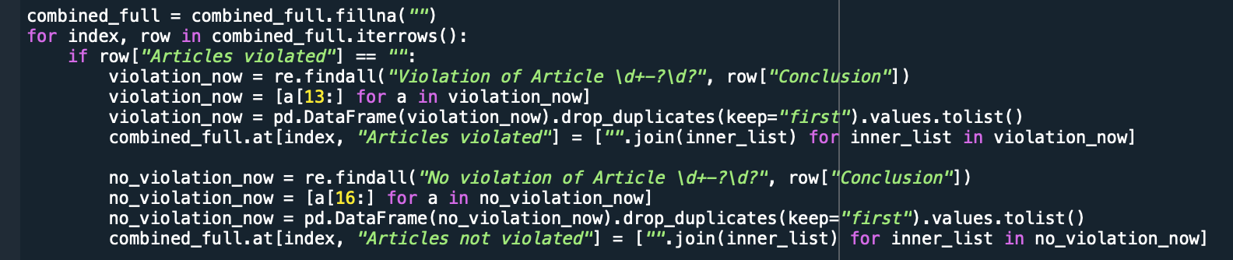
Preparing the data
Differences between the .csv files
Handling missing values and different names of columns
Extracting articles violated and articles not violated from conclusion
Dropping duplicate cases

Slide 6
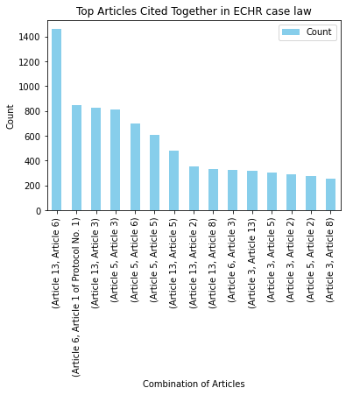



Article combinations
Using Combinations and Counter
Had to limit the chunk size for the code to work
Making sure all types of article formats are accommodated for
Putting out findings in a graph:

Slide 7
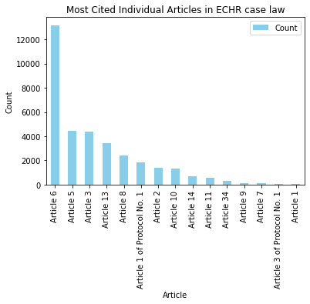
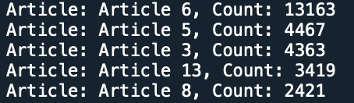
Frequency of Articles
Checking whether findings also correspond with overall trend in ECHR case law

Slide 8
Analysis of the Findings

Slide 9





MOST PAIRED ARTICLES

Slide 10
Article 6
safeguards the right to a fair trial
Article 13
guarantees the right to an effective remedy for violations of rights under the ECHR
⇒ suggests cases where individuals allege a violation of their right to a fair trial and seek an effective remedy for this violation after the exhaustion of domestic remedy ⇒ the importance of having an effective remedy available at a national level

Slide 11
of Protocol No.1

Slide 12
Article 6
safeguards the right to a fair trial
Article 1 of Protocol No.1
protects the right to the peaceful enjoyment of possessions
⇒ issues related to fair trial rights in conjunction with property rights (disputes over property ownership, confiscation, or expropriation) ⇒ importance of considering property rights in the context of fair trial rights, particularly in cases where property rights may be affected by legal proceedings

Slide 14
Article 3
prohibits torture, inhuman, or degrading treatment or punishment
Article 13
guarantees the right to an effective remedy for violations of rights under the ECHR
⇒ the frequent citation of Articles 3 and 13 together suggests cases where individuals allege torture, inhuman treatment, or degrading conditions and seek an effective remedy for these violations

Slide 15


Slide 16
Article 3
prohibits torture, inhuman, or degrading treatment or punishment
Article 5
right to liberty and security, protecting individuals from arbitrary detention
⇒ cases where individuals allege violations of their right to be free from torture, inhuman or degrading treatment in the context of deprivation of liberty (ill-treatment or harsh conditions of detention)

Slide 17

Potential applicatios
5&3
6&1 (protocol 1)
advocacy for improved detention standards, enhanced safeguards against ill-treatment, and the promotion of human dignity within detention facilities.
Strengthen property rights advocacy within fair trial guarantees.
Advocate for legislative reforms recognizing the interplay between property rights and fair trial rights.

Slide 18
Benefits
Insights into the specific challenges faced by individuals seeking remedies for violations of their fair trial rights and highlight the importance of effective remedies in achieving justice at a national level
Insights into the interconnectedness of different rights within the ECHR framework
Guidance for stakeholders in identifying patterns and trends in human rights violations
Contribution to the development of legal arguments, advocacy strategies, and policy recommendations

